Slide 1


INFOSYS INTERNSHIP PROJECT PRESENTATION
Covering The Internship Undertaken With
On
“Image Captioning Using Deep Learning PROJECT”
From
25th May 2024 TO 19th July 2024

Slide 2

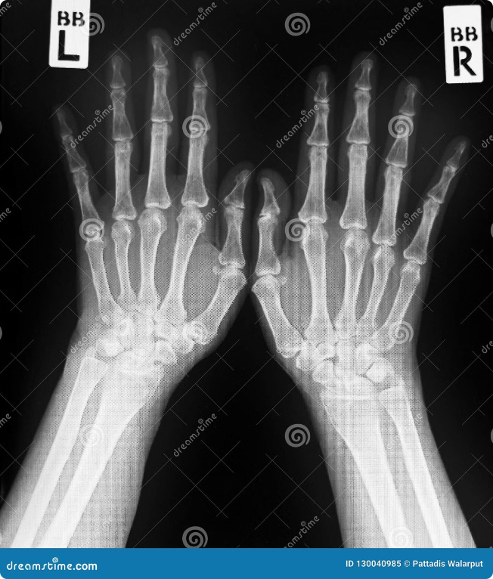
Use Case - 1
What is X-Ray Medical Image Captioning?
X-ray medical image captioning is a field of artificial intelligence that focuses on automatically generating textual descriptions of medical x-ray images. This technology aims to assist radiologists and other healthcare professionals by providing concise and informative summaries of the images, which can help in diagnosis and treatment planning. The process involves training machine learning models on a large dataset of x-ray images paired with their corresponding captions. These models learn to recognize patterns and features in the images and associate them with appropriate words or phrases. The generated captions can describe various aspects of the image, such as anatomical structures, abnormalities, and potential diagnoses.

Slide 3


Continued…
X-ray image captioning has several practical applications in healthcare settings. For instance, it can be used to automate the creation of radiology reports, which can save time for radiologists and improve efficiency in the diagnostic process. This technology can also be used in patient education, providing patients with a clear and concise explanation of their x-ray findings. Additionally, it can help in telemedicine applications, where remote healthcare professionals can access and interpret x-ray images more effectively. In research settings, x-ray image captioning can be employed to analyze large datasets of x-ray images, helping to identify trends, patterns, and potential new discoveries.
1
Automated Report Generation
X-ray image captioning can automatically generate initial reports based on the image, providing a starting point for radiologists to review and refine.
2
Patient Education
The generated captions can be used to create easy-to-understand explanations of the findings for patients, improving communication and understanding.
3
Telemedicine Support
X-ray image captioning can enhance telemedicine consultations by providing concise summaries for remote healthcare providers, facilitating quicker and more accurate diagnoses.
4
Research and Analysis
By analyzing large datasets of x-ray images and their captions, researchers can identify patterns, trends, and potential new discoveries.

Slide 4

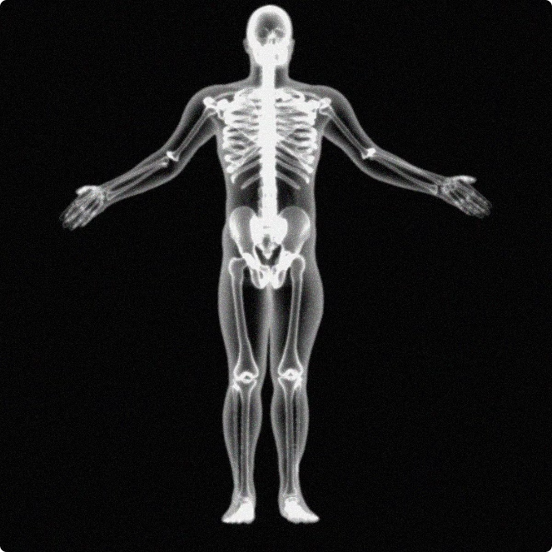
Importance
The importance of x-ray image captioning stems from its potential to revolutionize medical image analysis. This technology offers numerous advantages, including:
Improved Accuracy
By leveraging the power of machine learning, x-ray image captioning can improve the accuracy of diagnoses by providing comprehensive and detailed descriptions of the images.
Enhanced Efficiency
Automating the captioning process can save time for radiologists, allowing them to focus on more complex tasks and ultimately improving their productivity.
Reduced Errors
X-ray image captioning can help to minimize errors caused by human fatigue or oversight by providing consistent and accurate descriptions of the images.
Improved Patient Care
By enhancing communication and understanding between healthcare providers and patients, x-ray image captioning contributes to improved patient care and outcomes.

Slide 5

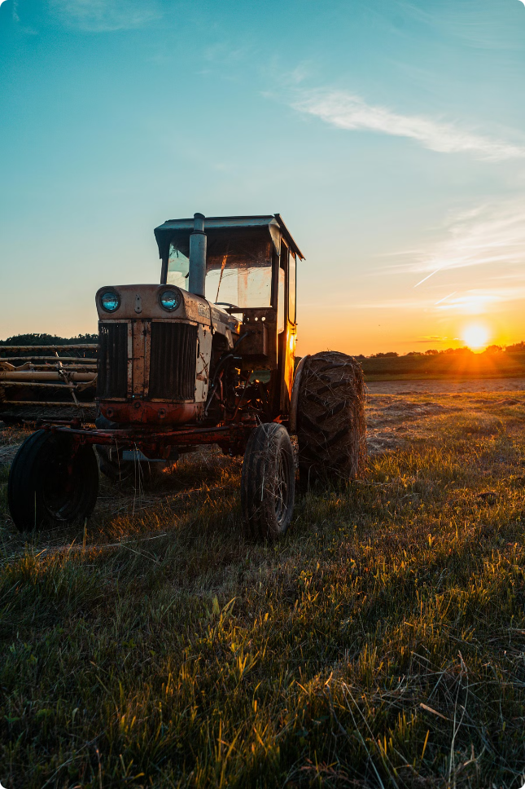
Use Case - 2
Agricultural Image Captioning for Smart Farming
Welcome to this presentation on agricultural image captioning. This technology revolutionizes farming by harnessing the power of computer vision to monitor crops and detect issues early.
Our objective is to build a model that can automatically classify crop type, identify growth stage, and detect health issues like pests or diseases from images.
This project can assist farmers and crop experts in monitoring crops remotely, detecting problems early, and optimizing resource management, ultimately leading to improved yields.

Slide 6

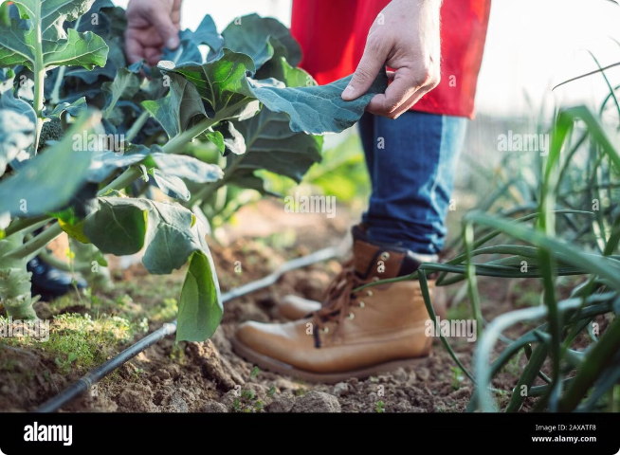
Continued…
1
Early Disease Detection
Diagnosing plant diseases early is crucial for maximizing crop yields and mitigating economic losses.
2
Image-Based Techniques
Image analysis provides a non-invasive and efficient way to monitor plant health and identify issues.
3
Model Development
We aim to develop a model capable of identifying crop conditions and generating descriptive captions from images.
4
Global Food Security
This technology has the potential to improve crop management practices and support global food security.

Slide 7
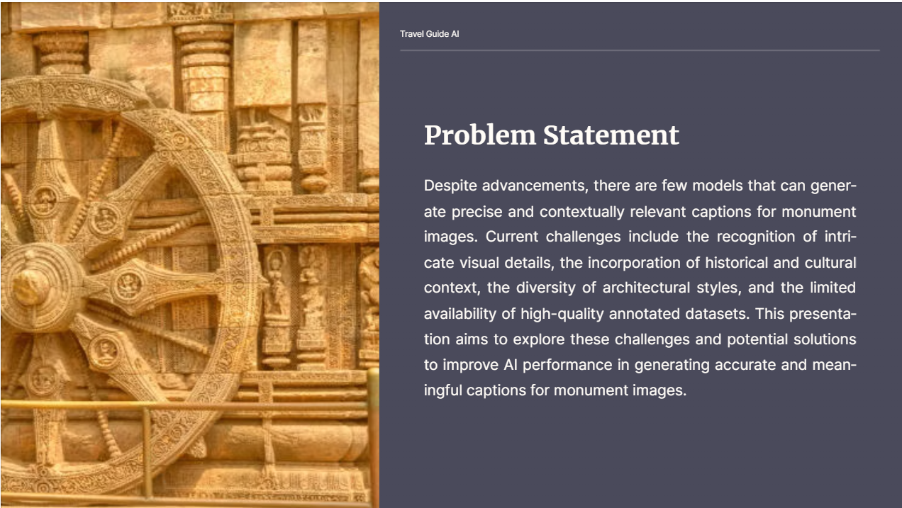
Use Case - 3

Slide 8


Slide 9


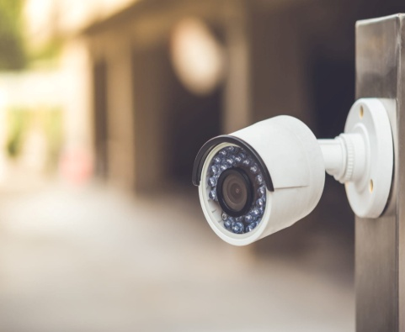
Use Case - 4
Automated CCTV monitoring enhances business security and operational efficiency by providing real-time surveillance, reducing labor costs.
Real-Time Monitoring
Cost Efficiency
Enhanced Security

Slide 10
Data Preprocessing
Before training an image captioning model, data preprocessing is essential to prepare the data for optimal performance.
Image Resizing
1
Images are resized to a consistent size for efficient processing by the model.
2
Text Cleaning
Captions are cleaned by removing punctuation, converting to lowercase, and applying other necessary transformations.
Tokenization
3
Captions are split into individual words or tokens, which are then used to create a vocabulary for the model.
4
Padding and Truncation
Captions are padded or truncated to a fixed length, ensuring consistency in the input to the model.

Slide 11

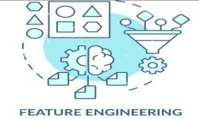



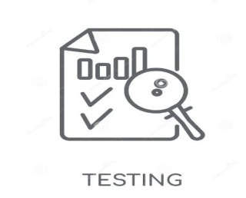
Model Building Work Flow
Data Preprocessing
Preprocess the images and text for building better model.
Feature Engineering
Extract the features from the images for better model building by using VGG16 pre trained model and store the features into pickle file.
Mapping of Image to Captions
create mapping of image to captions
Result Analysis
Analysis the result by Blue Score metric.
Model Training
Train the model by 90% train dataset and save the model .
Model Creation
Creating a model to generate a perfect caption of the picture
Splitting the dataset
Splitting the entire dataset into train and test dataset. Took 70% of train data and 30% test data.

Slide 12

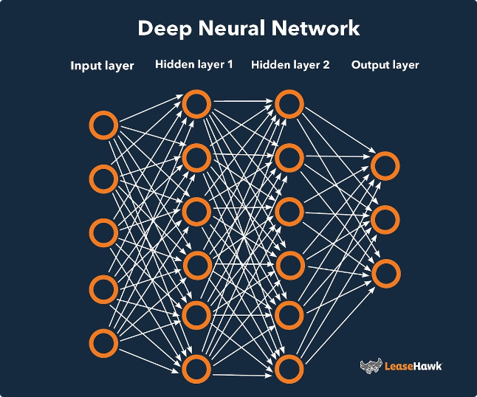


Workflow of the Model
Image captioning models typically follow a workflow that involves two main components: an encoder and a decoder.
Image Encoder
This component extracts features from the input image using convolutional neural networks (CNNs).
Decoder
This component takes the encoded image features as input and generates a textual caption using a recurrent neural network (RNN) or a transformer architecture.

Slide 13
Model Architecture
Image captioning models commonly use encoder-decoder architectures, such as CNN-RNN or transformer-based models like Vision Transformer (ViT). These models leverage convolutional neural networks to extract visual features from the input image, and recurrent or transformer-based networks to generate the corresponding textual description.
Learning Rate
Epochs
Batch Size
The learning rate controls the step size during optimization, impacting the model's training speed and convergence. Selecting an appropriate learning rate is crucial for efficient and effective model training.
The number of passes through the entire training dataset influences the model's learning and performance. Adjusting the number of epochs helps ensure the model is trained for an appropriate duration to achieve optimal results.
The batch size, or the number of samples processed in each training iteration, affects memory usage and training efficiency. Selecting the right batch size can help balance these factors and improve the overall training process.

Slide 14
Evaluation
Metric Selection
Qualitative Analysis
Choose appropriate evaluation metrics, such as BLEU, METEOR, and CIDEr, to assess the quality of the generated captions for images.
Manually review the model's output on images to identify areas for improvement and gain insights into its strengths and limitations.
1
2
3
4
Validation and Testing
Benchmarking
Split the image dataset into training, validation, and test sets to evaluate the model's performance on unseen data.
Compare the model's performance to state-of-the-art image captioning approaches to measure its effectiveness.

Slide 15
Project
Dashboard/Demo

Slide 16



Conclusion and Future Scope
Image captioning has made significant progress in identifying the context and describing the input image, but there are ongoing efforts to improve its accuracy, fluency, and ability to capture nuanced details and context.
Video Captioning
Multilingual Captioning
Extending image captioning to generate descriptions for video sequences.
Developing models that can generate captions in multiple languages.
Creative Captioning
Generating more descriptive and engaging captions that go beyond simple descriptions.

Slide 17
THANK YOU!

